Slide 1
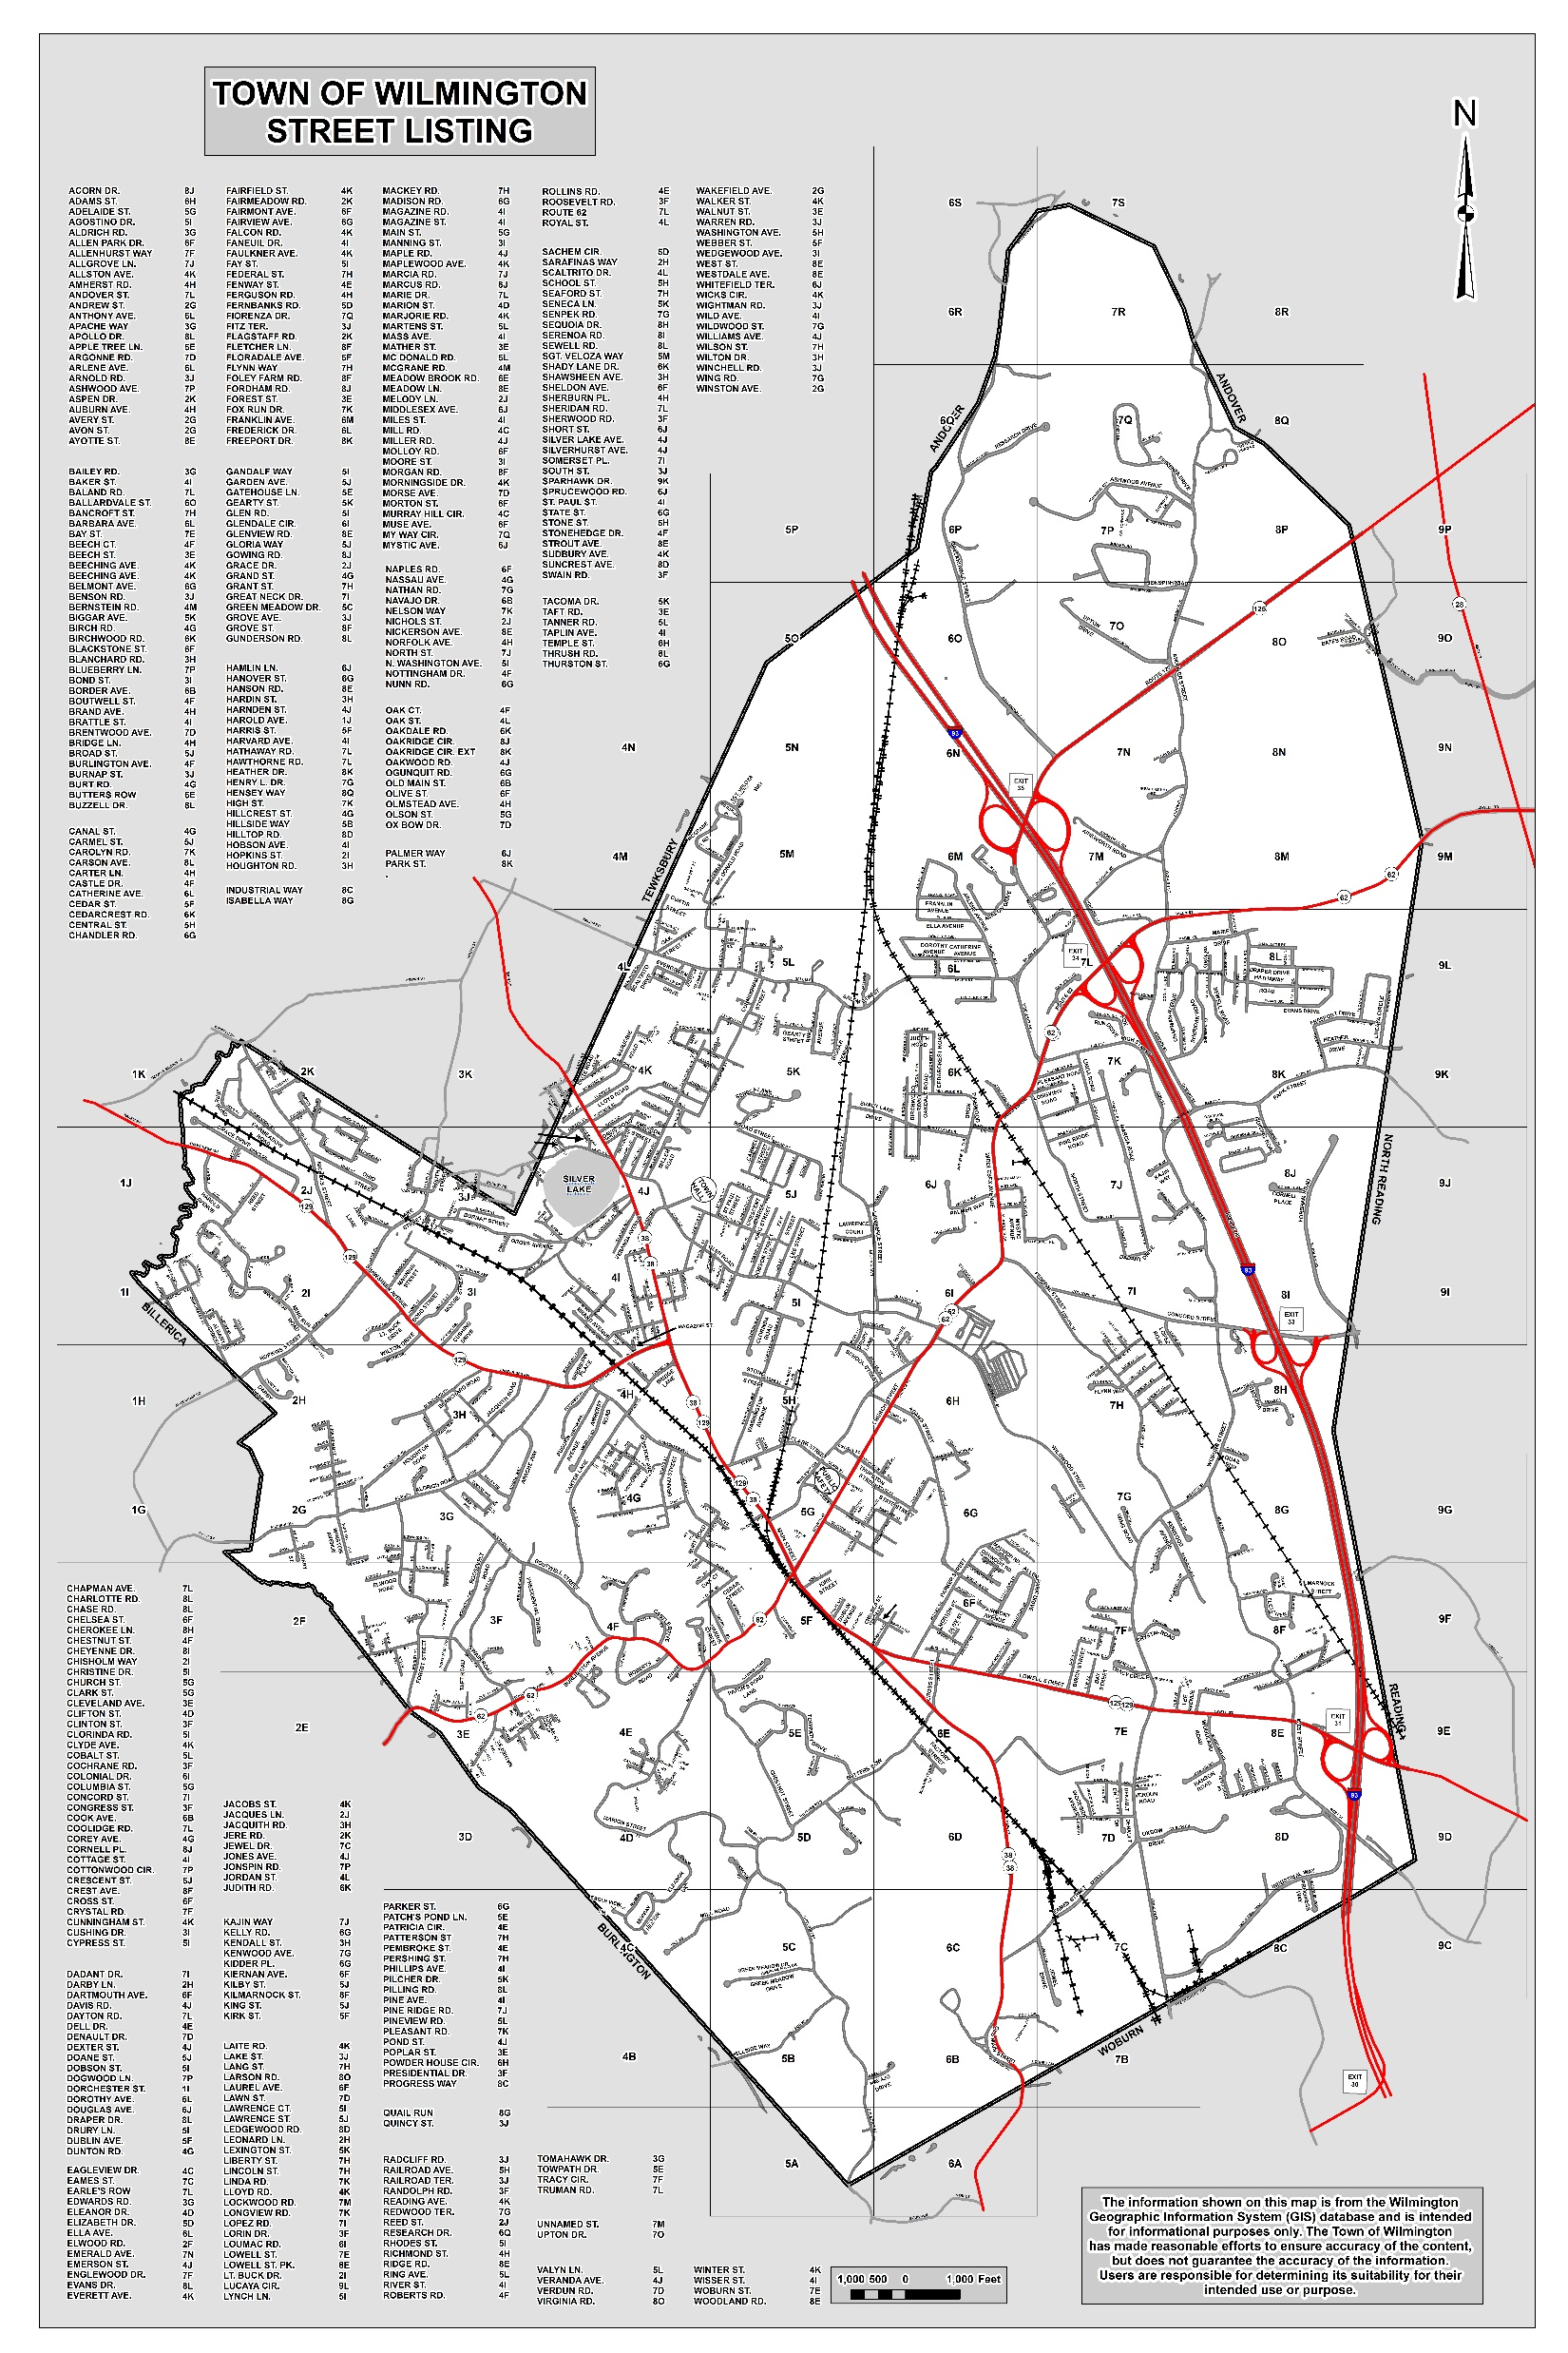
Town Clean-up Day
April 22, 2023
1
2
3
5
6
4
12
7
9
10
11
8
Notes:
Town Forest
Ashwood Ave/Brookfield Estates
Hathaway Acres
Town Hall/Glen Rd Berry Bog
Silver Lake and Wild Ave
Fisherman’s Access / Grace Dr.
Blanchard Rd.
Glen Rd.
Wildwood St.
Yentile Farm
Town Park
Murray Hill, Green Meadow, Mill Rd.

Slide 2
Town Forest
Ashwood
Ave
Hathaway
Acres
Grace
Drive
Town
Hall
Silver Lake
Wild Ave
Glen
Road
Blanchard
Road
Wildwood
Ave
Yentile
Farm
Town
Park
Murray Hill
Green Meadow
Mill Road

